Slide 1
Applied Parallel Computing with Python – Map/Reduce
PyCon 2013

Slide 2
Goal
Introduce map/reduce using Disco
Count words and filter for interesting things
Counting social interactions
Practical configuration

Slide 3
Overview (pre-requisites)
Disco (and erlang)
Matplotlib (for visualisations)
Cython+PIL/pillow+scikit-learn (for visualisations)
NetworkX (for the social network visualisation)

Slide 4
Disco
Disco – Python + Erlang
http://discoproject.org/
Install needs some experience
Small but friendly community
DDFS Filesystem
Web management view
Assumes node failures will occur

Slide 5
Disco
Assumes no communication between nodes
Can chain multiple map/reduce processes
Very good for line processing on big, growing data sets

Slide 6
What is map/partition/reduce?
Take paper
Count frequency of “the”, “of”, “oochy”
Partition using a hash function, send data
Reduce partial counts to one count
Return the complete results to master
What if a node had died?

Slide 7
Web interface
Let's run disco:
DISCO_HOME $ bin/disco nodaemon
Check it in the browser:
http://localhost:8989/
1 node with 1 worker
Be aware of localhost vs hostnames

Slide 8
Our data
Count words in 357 tweets on 1 machine
./2_MapReduceDisco/tweet_data/
Lines of JSON-encoded data
Approximately 12 words per line * 357 lines
4,500 words to count, lots are repeated

Slide 9
Running tiny example
Count words in 357 tweets on 1 machine
./2_MapReduceDisco
This is a generator function
Returns (key,value) pair
Do->Split the line into words
Do->Yield a count of 1 per word
$ python count_tweet_words.py
->mapreduceout_wordcount.json

Slide 10
What's going on?
Check localhost:8989 → job (right)
Takes a list of files (we have 1)
Utilises local filesystem
import count_tweet_words #why?

Slide 11
What's the output?
mapreduceout_wordcount.json
1968 lines of counted words
$ python word_count_cloud/plot_from_mapreduce.py mapreduceout_wordcount.json

Slide 12
Running larger example
Count words in 859,157 tweets on 1 machine
12*859157==10,309,884 rows to count
Same code, different input
$ python count_tweet_words.py
->mapreduceout_wordcount.json
Check localhost:8989 → job (right)
Maybe you run out of RAM? 1.9GB...

Slide 13
Use a combiner
from disco.func import sum_combiner
Job()(..,combiner=sum_combiner)
Run it again – 100MBs only
It does the counting after mapping

Slide 14
Using DDFS
./tweet_data
$ split -l 100000 tweets_859157.json # xaa..xai
Run it again – 100MBs only
$ ddfs chunk data:tweets859157xa ./xa?
We've created 9 input files
Lives in DISCO_HOME/root/ddfs

Slide 15
Run with DDFS
from disco.func import chain_reader, sum_combiner
input = ["tag://data:tweets859157xa"]
job=...map_reader=chain_reader,
Run it again – takes 1 minute
Configure 4 workers in web interface
Now it takes about 30 seconds

Slide 16
Reduction?
Reduction occurs on each machine, hashed to a machine (data shuffled, can move) – counts for keyX → same machine
This shuffling means that reduction occurs evenly over machines
Sort pairs
Reduce same keys to 1 value
Combine results back on master

Slide 17
Now visualise again
$ python word_count_cloud/plot_from_mapreduce.py mapreduceout_wordcount.json
What about word frequencies – Zipf distribution?
$ python check_word_frequencies.py

Slide 18
Your task
You need to filter for “samsung” tweets (or “olympics” or “london”)
“filter_word in tweet.lower()”
“yield "", 0” # means ignore me
How does the visualisation change?

Slide 19
Now we'll count interactions
Run my example:
count_tweet_words_6.py
$ python draw_interactions_graph.py
Who is talked at a lot?

Slide 20
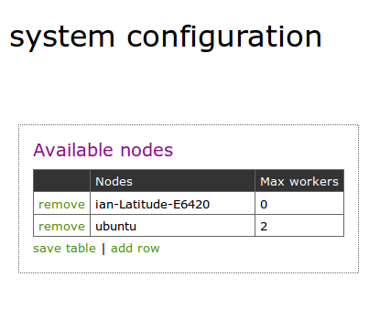
Multi-machine configuration
/etc/hosts
  127.0.0.1 localhost
  127.0.1.1 ian-Latitude-E6420
  192.168.0.32 ubuntu

Slide 21
Feedback
Write-up: http://ianozsvald.com
I want feedback (and a testimonial please)
“High Performance Python” book/site?
ian@ianozsvald.com
Thank you :-)

